Slide 1
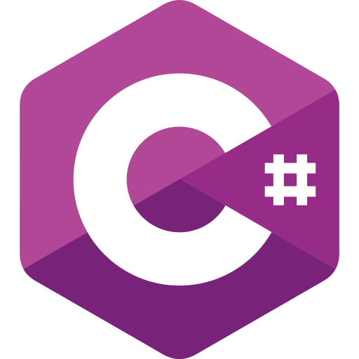
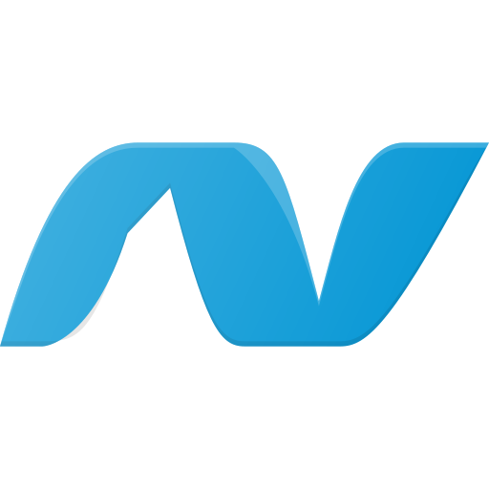
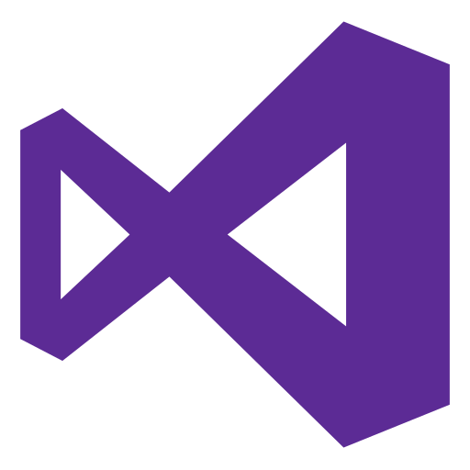
Day 1
Introducing of dot net
Installation
Create New Project
Learn Dot Net
By : RudiTech

Slide 2
Note
Before starting this lesson, make sure you have studied the concepts of API and C# programming language.
Learn Dot Net
By : RudiTech

Slide 3
What is dot net?
Dot net or .NET is a software development platform by Microsoft used to build various types of applications, including web, desktop, mobile, and cloud apps. It supports multiple programming languages like C#, F#, and VB.NET, and provides libraries and tools to streamline the development process.
Learn Dot Net
By : RudiTech

Slide 4
Installation
You need to install the .NET SDK and Visual Studio or Jetbrains Rider as the IDE.
.Net SDK : Download .NET (Linux, macOS, and Windows) | .NET
Check dot net version using terminal use command dotnet --version
Visual Studio : Visual Studio: IDE and Code Editor for Software Development
Jetbrains Rider : Download Rider: The Cross-Platform .NET IDE
Learn Dot Net
By : RudiTech

Slide 5
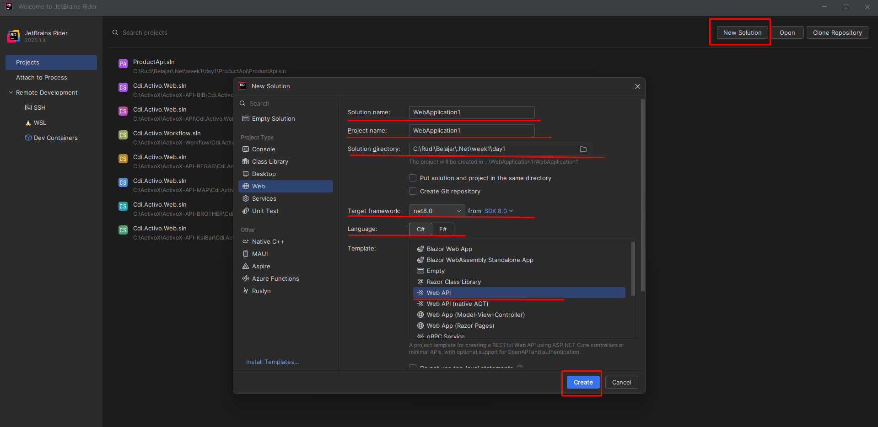
Create New Project
You can use visual studio to create a new project
Create directory for your project
Open Rider
New Solution
Fill in project name and solution name
Choose directory
Choose target framework (using Lts, now net 8)
Choose language (C#)
Choose template (Web API)
Learn Dot Net
By : RudiTech

Slide 6
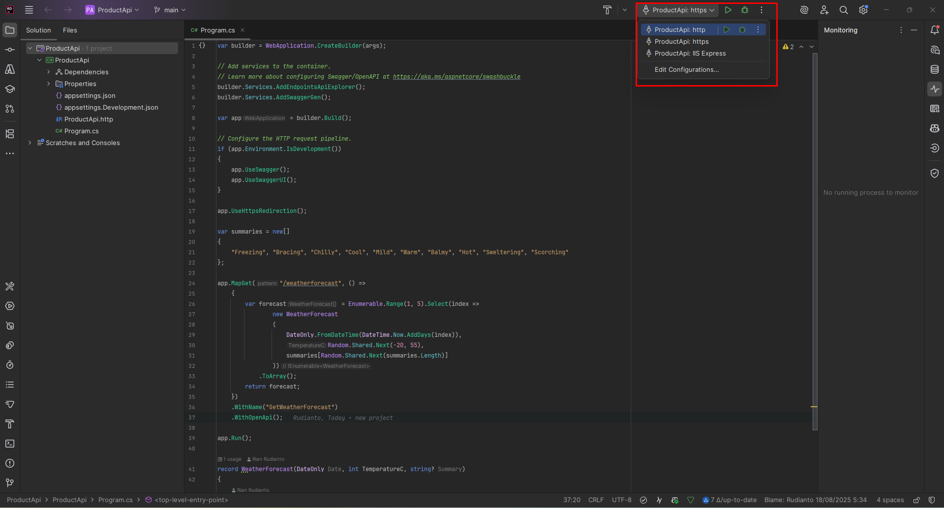
Run the app
To run the app you can choose to use http, https or IIS express
Learn Dot Net
By : RudiTech

Slide 7
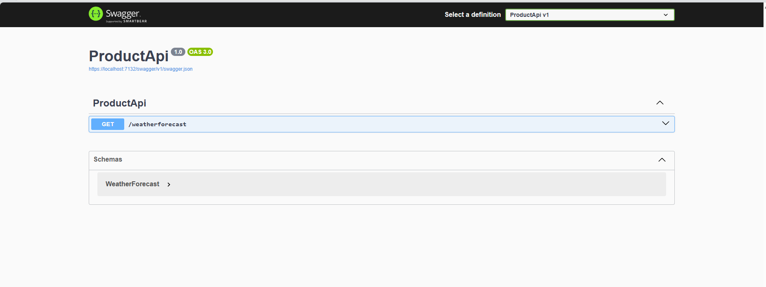
Result Swagger UI
Learn Dot Net
By : RudiTech

Slide 8
Day 2
Create First Endpoint
Learn Dot Net
By : RudiTech

Slide 9
Structure project web API
Controller : contains the controller file (API Endpoint)
Models : contains file for data (DTO/Entity)
Program.cs : mainte app configuration
appsettings.json : configuration (database)
Learn Dot Net
By : RudiTech

Slide 10
What is Controller?
Controller is the gateway to the web API
For example default controller when first create dot net web api is WeatherForecastController
The controller contains action methods to handle HTTP requests.
GET : For get data
POST : For add data
PUT : For update data
DELETE : For delete data
Learn Dot Net
By : RudiTech

Slide 11
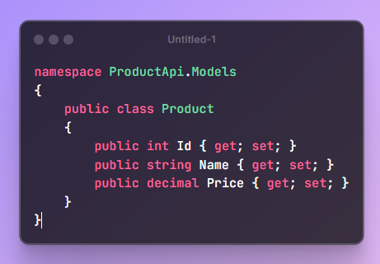
Create Product Model
To create product model you need to create models folder then create a file named Product.cs
Learn Dot Net
By : RudiTech

Slide 12
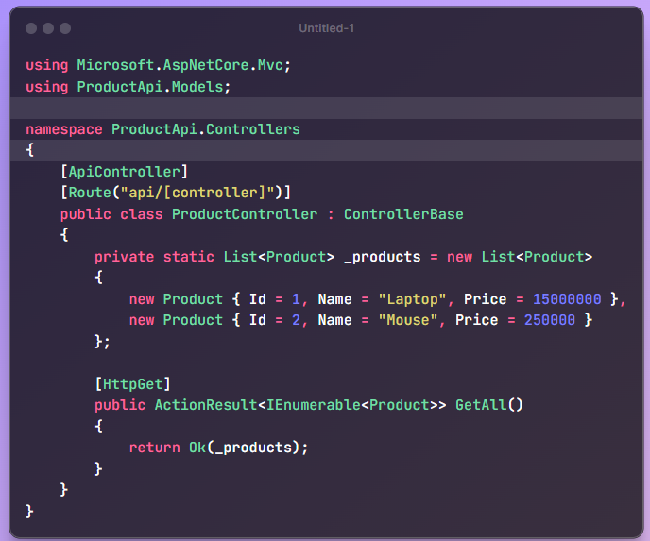
Create Product Controller
To create product controller you need to create controller folder then create a file named ProductController.cs
Learn Dot Net
By : RudiTech

Slide 13
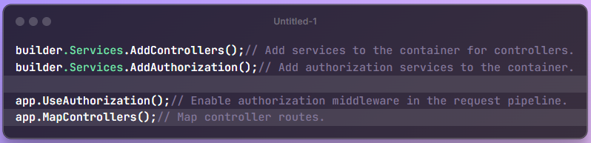
Configuration Program.cs
On Program.cs file you need to add some sections
Learn Dot Net
By : RudiTech

Slide 14
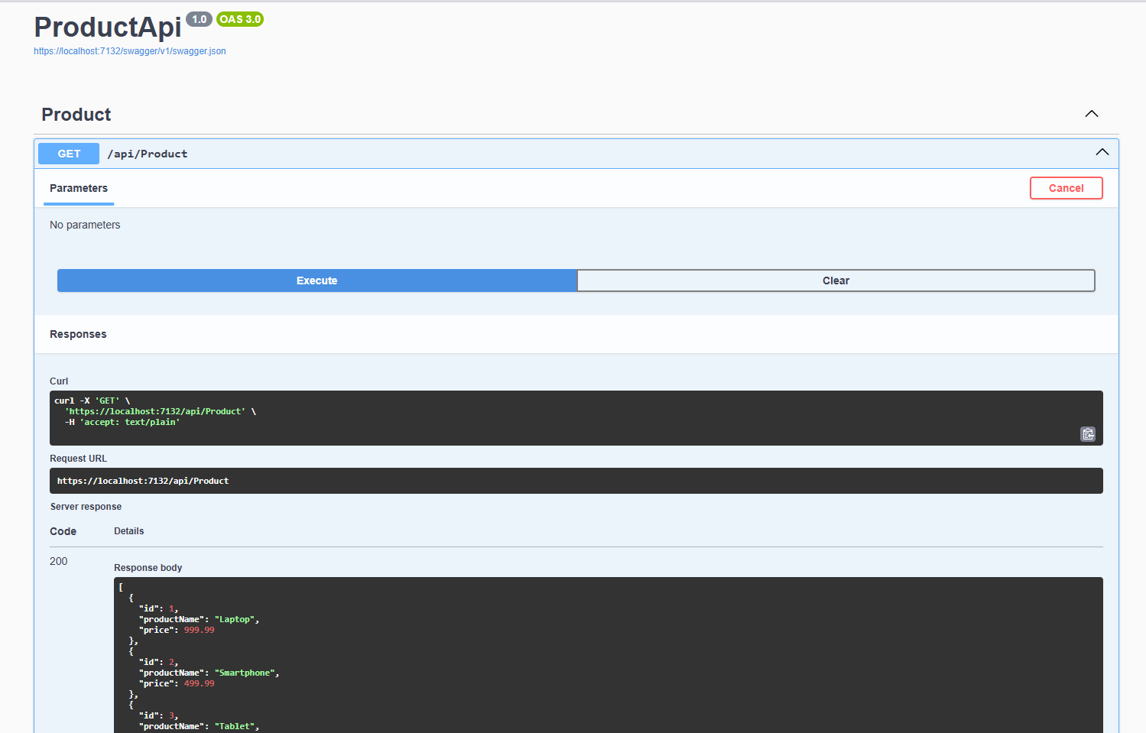
Run app and check on swagger
Learn Dot Net
By : RudiTech

